Slide 1

Slide 1
CAPSTONE IDEAS

Slide 2

1. Augmented Dress Trial
2. Text Summarization
3. Teaching with AR
4. Fruit and Vegetable Ripeness Detector
5. Plant Disease Detection and Cure

Slide 3
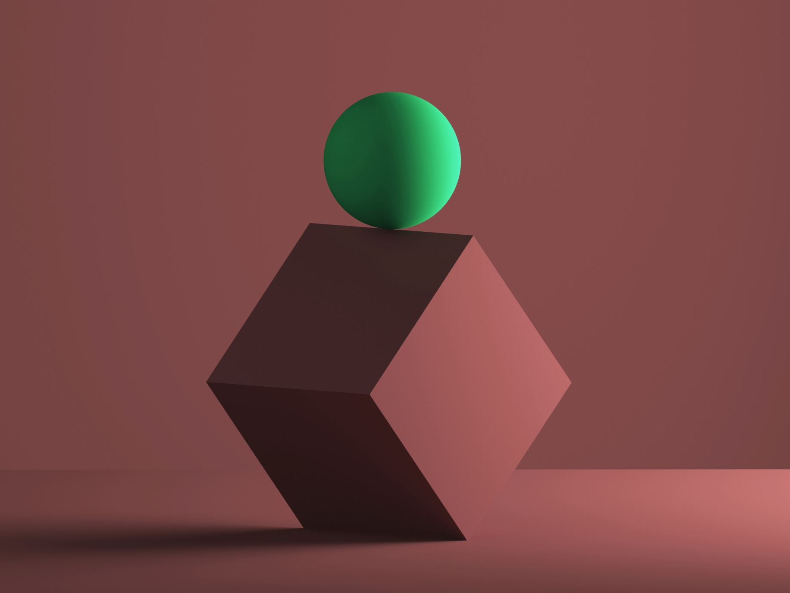
Augmented Dress Trial
Here the goal is to create a user-friendly application where any customer who is looking to try out clothes without leaving the comfort of their home get best shopping experience. We are planning to create AR based application for the experience enhancement.
Instead of just scrolling through the app, user will be able to check out how they would look wearing that particular item. We would like to recommend what goes best with that item as well.

Slide 4
Text Summarization
The intention is to create a coherent and fluent summary having only the main points outlined in the document. An application to get keyphrase extraction, document summarization which aims to identify the essence of a text.
The aim is to keep the flow of the material intact while pointing out the important features of the article.

Slide 5
Teaching with AR
Augmented reality animated content in classroom lessons could catch students’ attention in our dynamic day and age, as well as motivate them to study. Adding extra data, e.g. a short bio of a person, fun facts, historical data about sites or events, visual 3D models, would give students a wider understanding of topics.

Slide 6
Fruit and vegetable ripeness
Fruits change in color, size, weight, texture, flavor, and aroma (some even produce ethylene gas); these varied attributes can be good indicators of ripeness. Color is a clue, but not a reliable one. With some fruits, we can tell they're ripe by their color. As the acidity changes, the green chlorophyll breaks down.
We are planning to create an app by scanning the fruit/vegetable it shows the stage of the ripeness[Unripe/Ripe/Overripe/Rotten].

Slide 7
Plant disease detection and cure
The plant disease detection can be done by observing the spot on the leaves of the affected plant. The method we are adopting to detect plant diseases is image processing.

